Slide 1

Telecom Customer Churn Prediction

Slide 2

PROBLEM STATEMENT
Predict customer churn in a telecom company, focusing on interpreting model results for actionable insights.

Slide 3
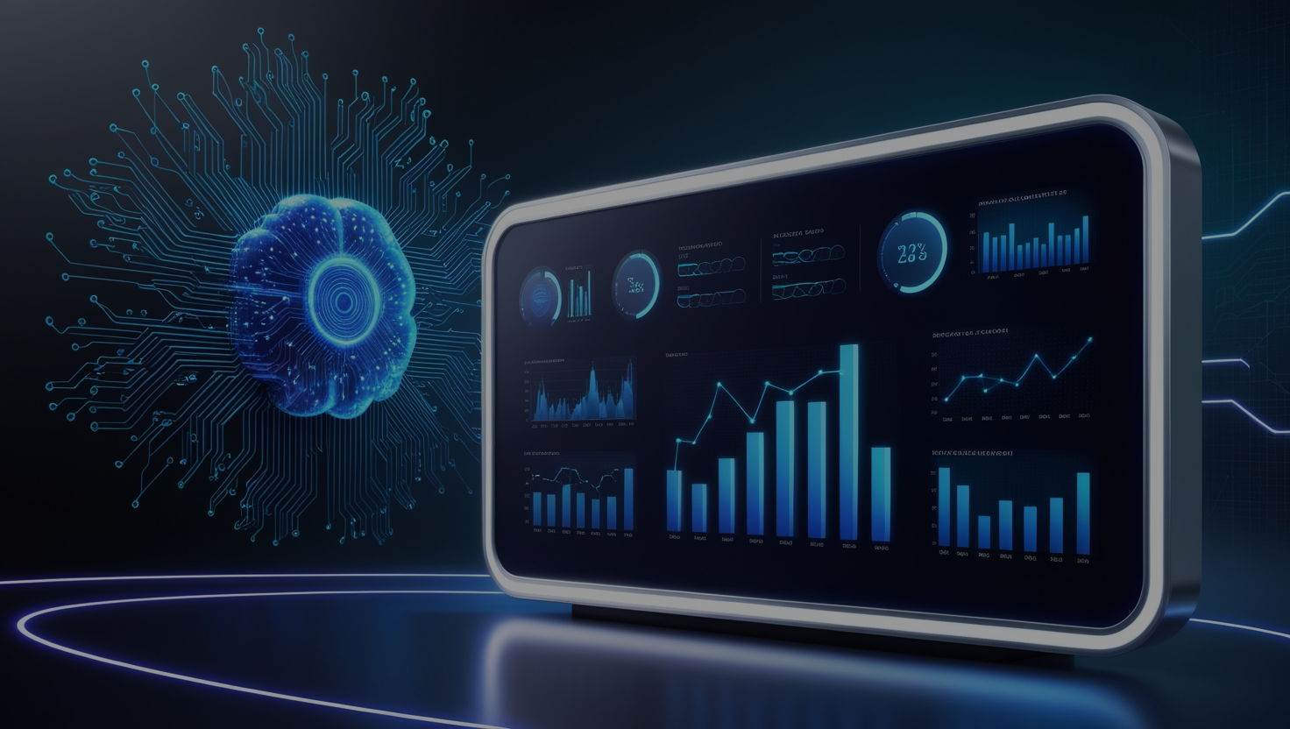
DATASETS [TELCO CUSTOMER CHURN]
- Contains 7,043 customer records from a telecom company. - Features include customer demographics, services subscribed, contract types, billing information, and churn status.
DATA PROCESSING
- Visualized data to understand customer characteristics influencing churn. - Key observations: - Month-to-month contract customers have the highest churn rate. - Customers using electronic check payment methods churn more frequently. - Longer tenure correlates with lower churn rates. Graphs: Churn by Contract Type, Tenure vs. Churn, Monthly Charges Distribution

Slide 4
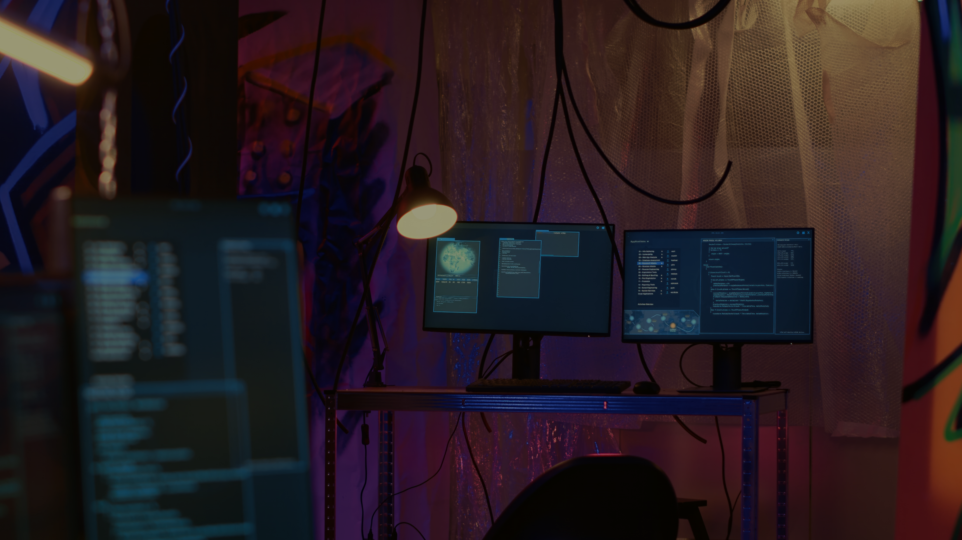
TOOLS USED
Numpy : A powerful library for numerical computations and arrays in Python. Pandas : A data analysis library providing data structures and tools for manipulating, analyzing, and cleaning data. TensorFlow : An open-source platform for machine learning, deep learning, and neural networks. Keras : A high-level API built on top of TensorFlow, simplifying the creation and training of neural networks. Matplotlib: A plotting library for creating static, animated, and interactive visualizations. Scikit-learn : A machine learning library offering algorithms for classification, regression, clustering, and more.

Slide 5

OUR SOLUTIONS
- Built a Web App using Python, allowing users to input customer data. - The app predicts whether a customer will churn based on their details (contract type, tenure, services, etc.). - Users receive an instant prediction on the likelihood of churn.
MODEL WE MADE
-Input Collection: Customer details (demographics, services, billing) are collected via a Streamlit interface. -Preprocessing: Data is encoded and scaled to match the training set structure. Prediction: A pre-trained TensorFlow model predicts churn based on processed inputs. -User Output: The prediction ("Churn" or "No Churn") is displayed in the interface​.

Slide 6
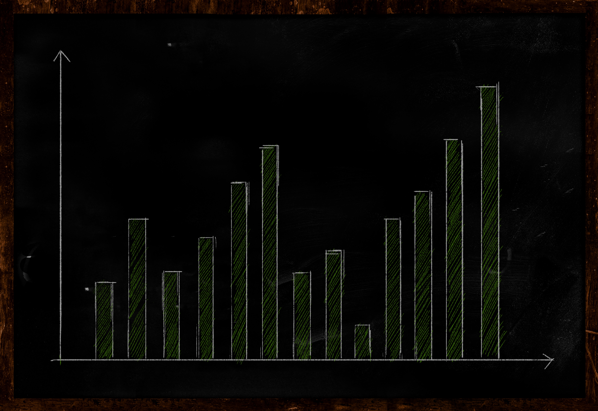
RESULTS
- Customers with month-to-month contracts and higher monthly charges are more likely to churn. - The app can be integrated into customer service workflows to target at-risk customers with personalized retention strategies. - Future enhancements include incorporating more customer data for higher accuracy and making the app more accessible.

